Slide 1
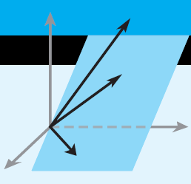
Elementary Linear Algebra
Howard Anton
Copyright © 2010 by John Wiley & Sons, Inc.
All rights reserved.
Chapter 10

Slide 2
Chapter 10
Applications of Linear Algebra
10.1 Constructing Curves and Surfaces Through Specified Points
10.2 Geometric Linear Programming
10.3 The Earliest Applications of Linear Algebra
10.4 Cubic Spline Interpolation
10.5 Markov Chains
10.6 Graph Theory
10.7 Games of Strategy
10.8 Leontief Economic Models
10.9 Forest Management
10.10 Computer Graphics

Slide 3
More Applications
10.11 Equilibrium Temperature Distributions
10.12 Computed Tomography
10.13 Fractals
10.14 Chaos
10.15 Cryptography
10.16 Genetics
10.17 Age-Specific Population Growth
10.18 Harvesting of Animal Populations
10.19 A Least Squares Model for Human Hearing
10.20 Warps and Morphs

Slide 4

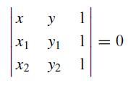
Section 10.1 Constructing Curves and Surfaces Through Specified Points
Finding the equation of a line between two points:

Slide 5
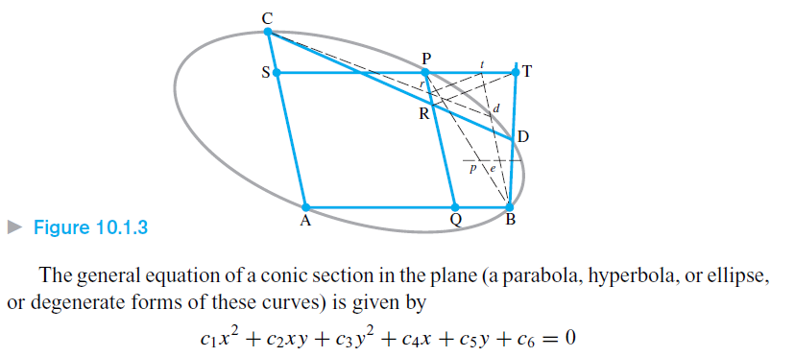
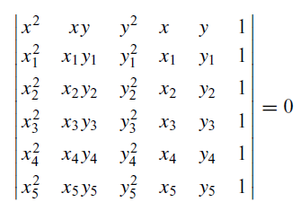
A conic section through 5 points

Slide 6
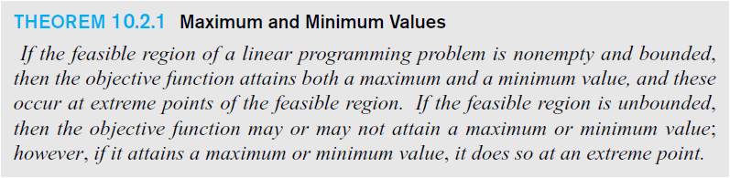
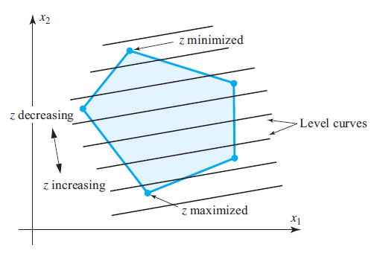
Section 10.2 Geometric Linear Programming

Slide 7
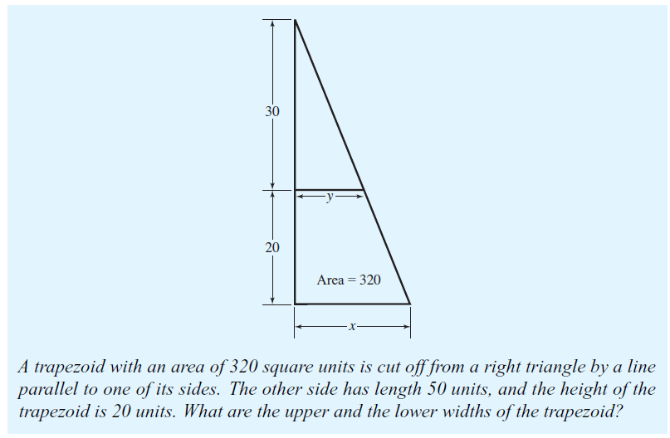
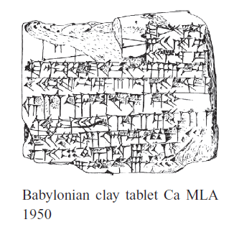
Section 10.3 The Earliest Applications of Linear Algebra

Slide 8
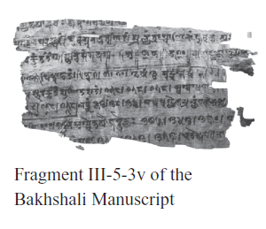
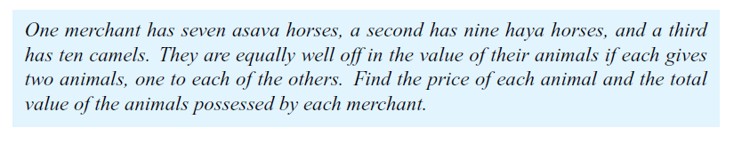

Slide 9
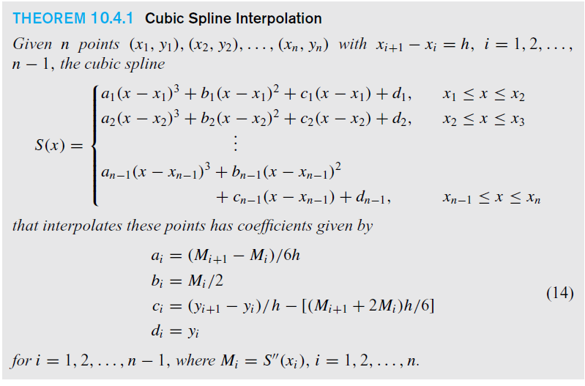
Section 10.4 Cubic Spline Interpolation

Slide 10
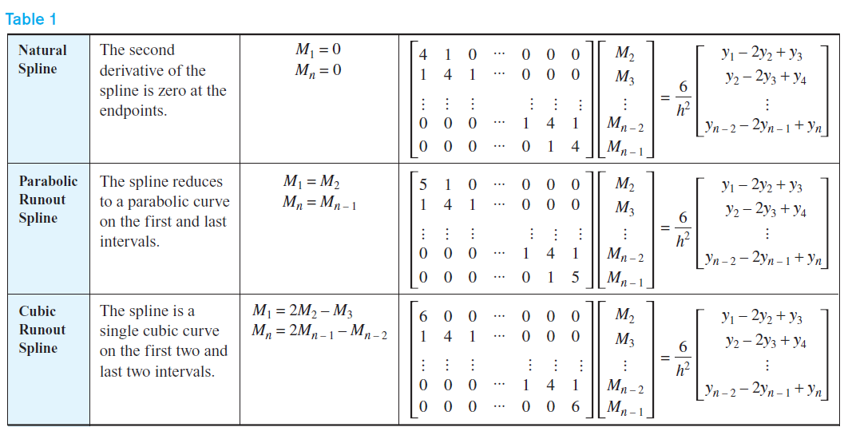


Slide 11
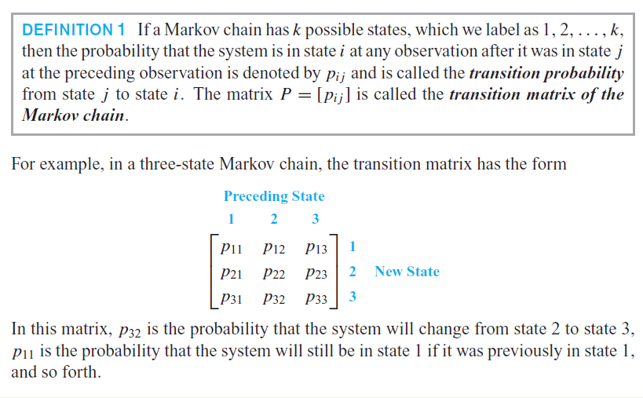
Section 10.5 Markov Chains

Slide 12

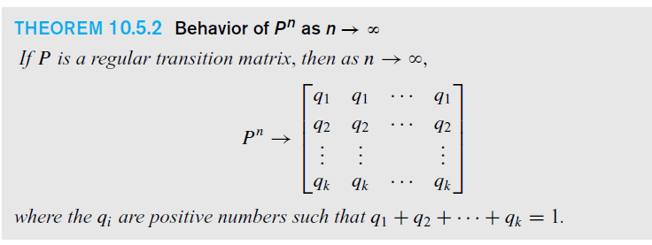
A regular transition matrix

Slide 13
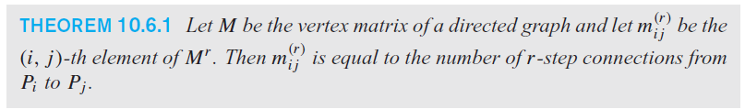
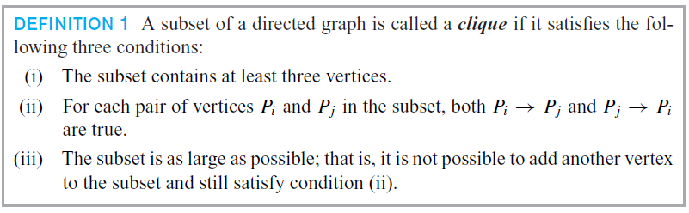
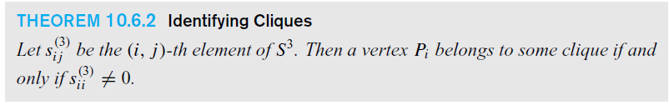
Section 10.6 Graph Theory

Slide 14

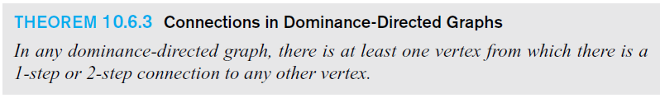
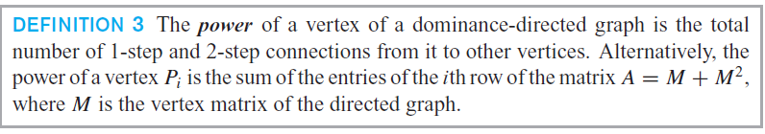
Dominance and Power

Slide 15
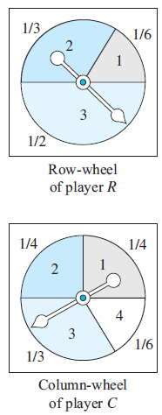
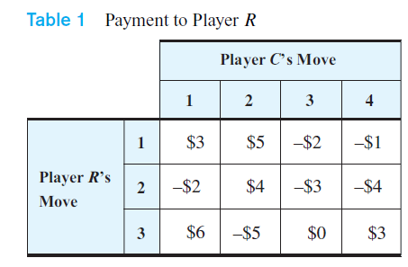
Section 10.7 Games of Strategy
A two-person zero-sum matrix game

Slide 16
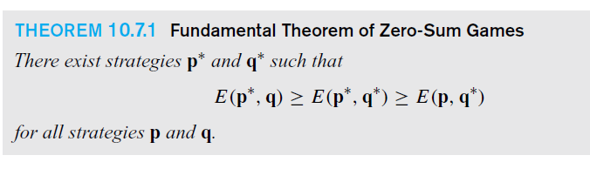
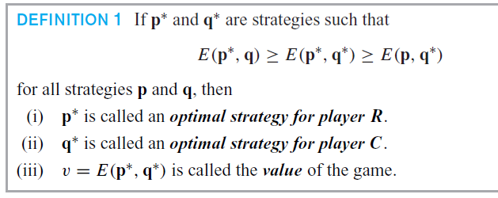

Slide 17
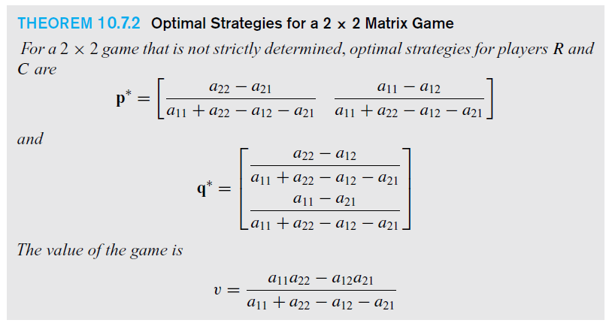
Optimal Strategies

Slide 18

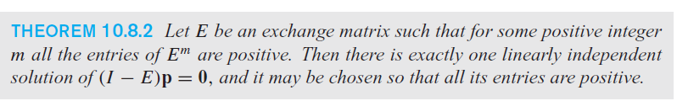
Section 10.8
Leontief Economic Models

Slide 19
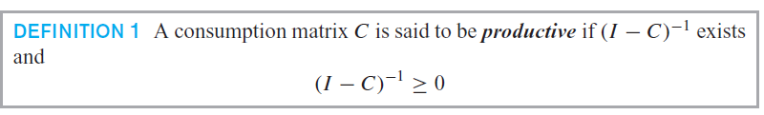
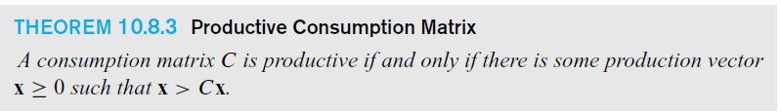
Productive Consumptive Matrix

Slide 20
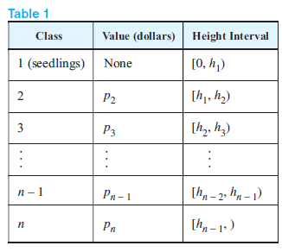
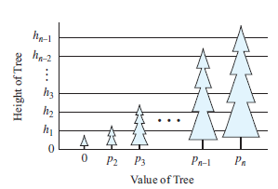
Section 10.9 Forest Management

Slide 21
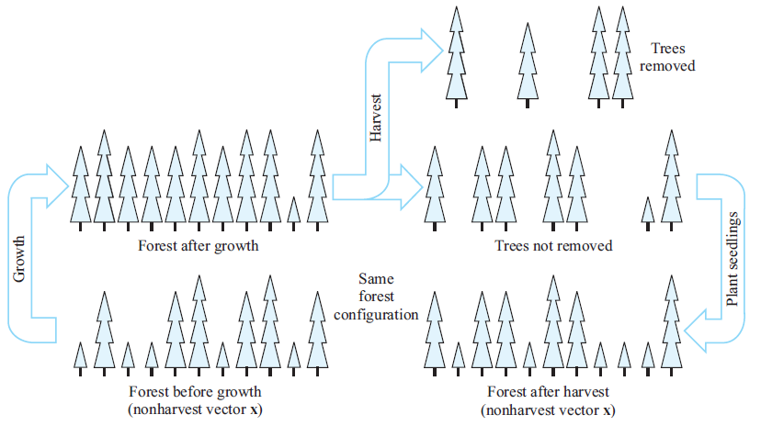
Forest Management

Slide 22
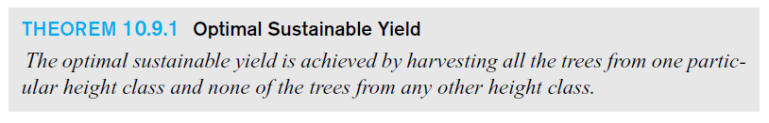
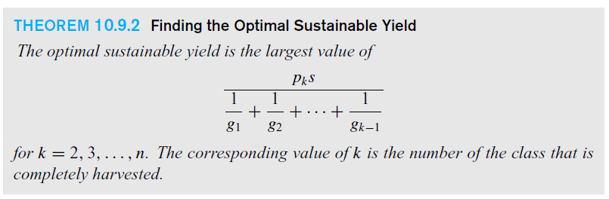
Optimal Sustainable Yield

Slide 23
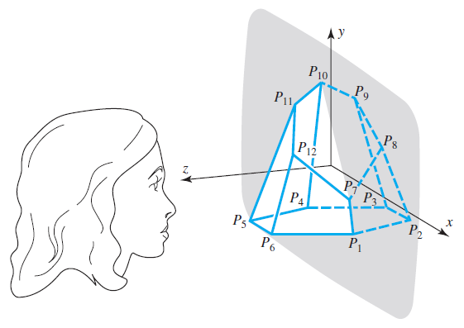
Section 10.10 Computer Graphics

Slide 24
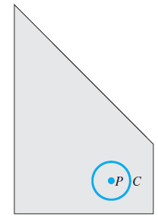
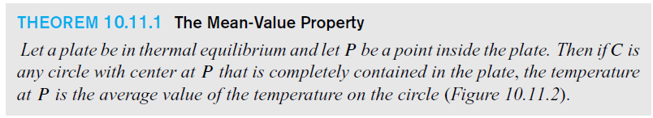
Section 10.11 Equilibrium Temperature Distributions

Slide 25
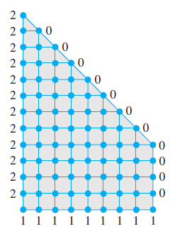
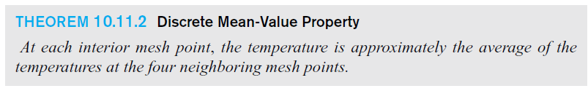
Discrete Mean Value Property

Slide 26
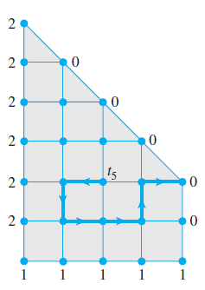
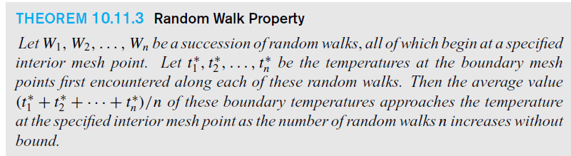
Monte Carlo Technique:
A Random Walk

Slide 27
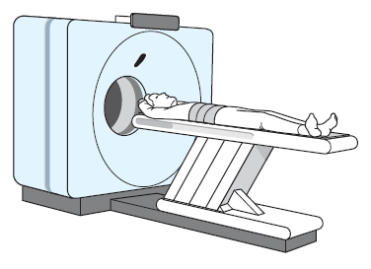
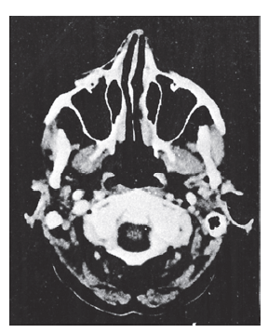
Section 10.12 Computed Tomography

Slide 28
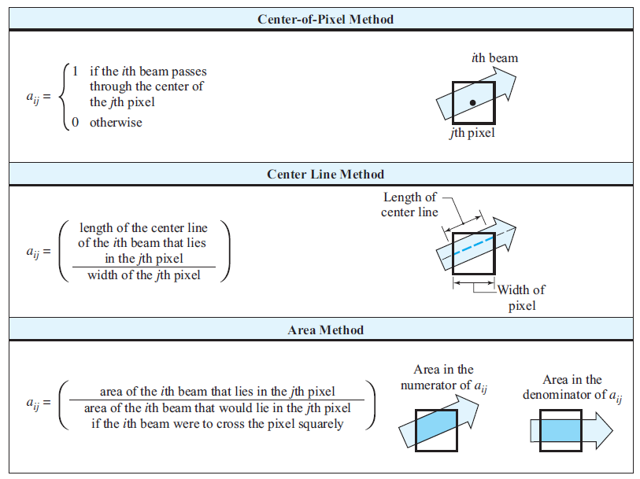

Slide 29
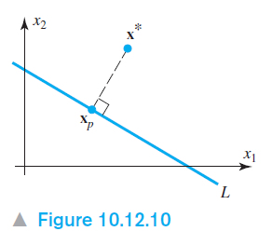
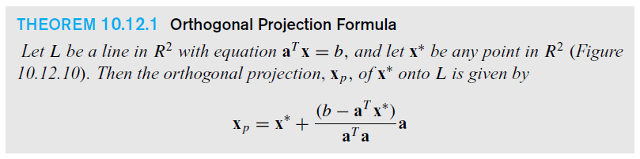
Orthogonal Projection Formula

Slide 30
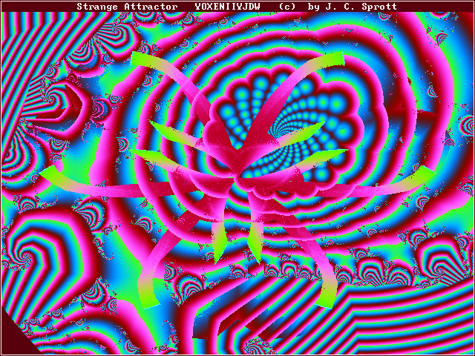
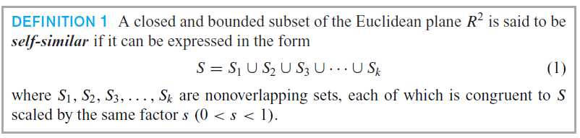
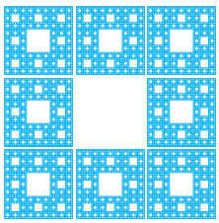
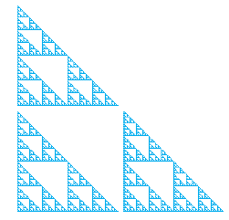
Section 10.13 Fractals
Serpinski Carpet Serpinski Triangle

Slide 31
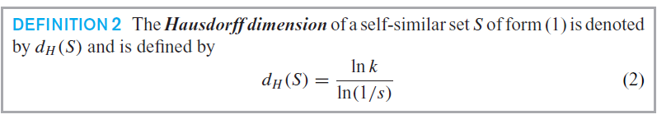
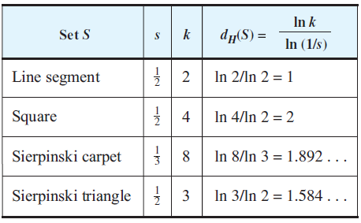
The Hausdorff Dimension

Slide 32

Fractals
Serpinski Carpet Serpinski Triangle

Slide 33

Section 10.14 Chaos

Slide 34

Section 10.15 Cryptography
Substitution ciphers:

Slide 35

Ciphering via Matrices
GTNKGKDUSK becomes STRIKE NOW

Slide 36

Section 10.16 Genetics
Autosomal Inheritance

Slide 37

X linked Inheritance

Slide 38



Section 10.17 Age-Specific Population Growth
Leslie model describing female population growth

Slide 39


Section 10.18 Harvesting of
Animal Populations

Slide 40

Optimal Sustainable Yield

Slide 41

Section 10.19 A Least Squares Model for Human Hearing

Slide 42

Least Squares Approximation to a Sound Wave

Slide 43

Minimizing error on [0, 2π]

Slide 44

Minimizing error on [0,T]

Slide 45

Section 10.20 Warps and Morphs
Triangulation and Warps

Slide 46


Time Varying Morphs

